Slide 1


Environmental Management Systems - EMS
IL “Sustainability & Environmental Management” SS 25
Kami Höferl
(Thomson, 1916, PD)

Slide 2

Overview
Where to start: CE & Quality Control
From QMS to EMS
The ISO 14001 Approach
The EMAS Approach
(Thomson, 1916, PD)
(Escher, 1961)

Slide 3
Where Did we Stop Last Time?
🤔

Slide 4
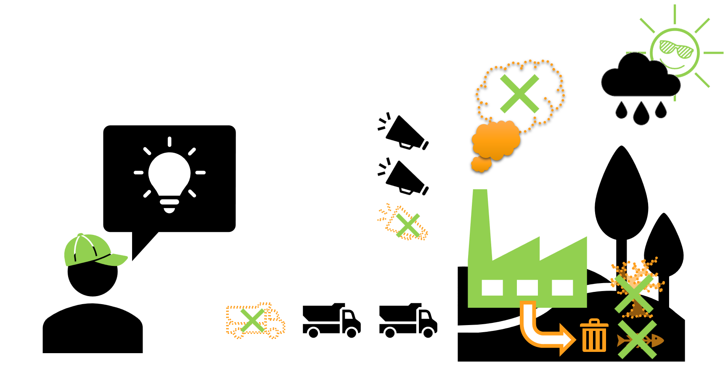









So … Some more Steps to setting the Playfield
Company XY

Slide 5

What’s Next?
 | Focus on …
 | Substance |  | Procedure
Voluntary
Mandatory
✅
Carbon Neutral
✅
Cradle to Cradle
Further CSR activates
✅
✅
✅
Life Cycle Assessment
Eco-Labels
B-Corp
ESG reporting: GRI, SASB, ISSB etc.
Climate-focused reporting: TCFD & CDP
Social-focused standards: SA8000
Sector-specific standards: OECD Due Diligence Minerals
XY
Environmental Management
Sustainability Management
EU CSRD
ISO 14001 EMAS
CE Marking
XY
EU Industrial Emissions Directive (IED)
EU Corporate Sustainability Due Diligence Directive (CSDDD)
✅
EU Emissions Trading System (ETS)
EU Green Claims Directive
Env. Impact Assessment (EIA)
Nat. regulations on air, waste, water & soil
✅
✅

Slide 6

So …
👉 give me more tools!

Slide 7
From CE over QMS to EMS

Slide 8
So …
Company XY

Slide 9


So …
Company XY

Slide 10
So …
Health & safety standards
Environmental Standards
Company XY

Slide 11
CE …
🤔

Slide 12
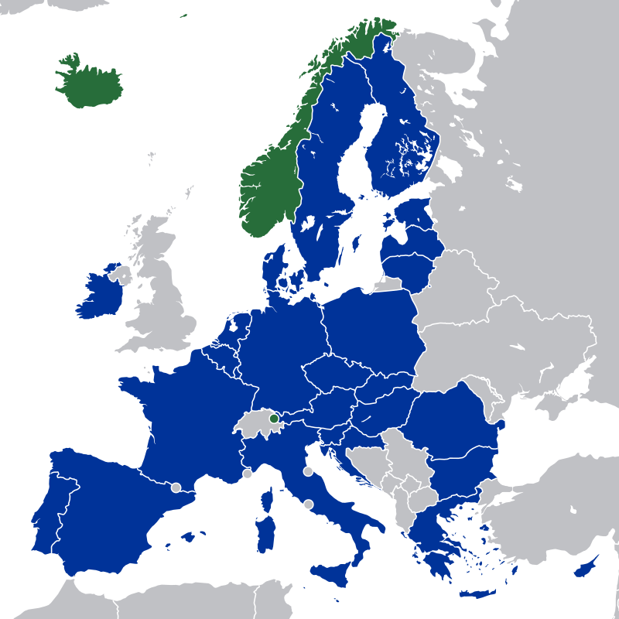
The European Economic Area (EEA)
EU 27
Plus:
Iceland
Liechtenstein
Norway

Slide 13
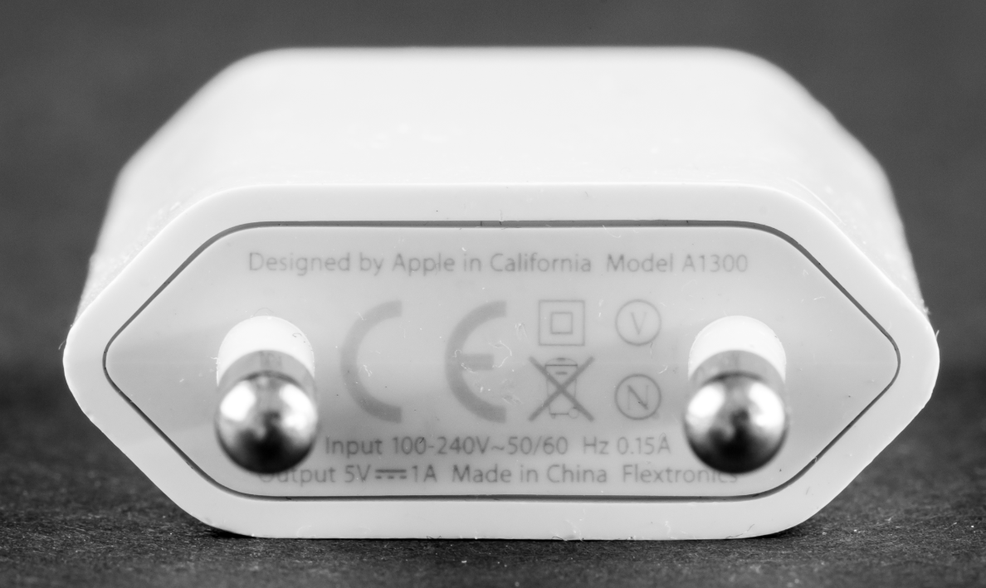
CE – or: Conformité Européenne

Slide 14
So CE for Everything?
Product family | Core directive / regulation | Typical products
Electrical & electronic equipment | Low-Voltage (LVD), EMC, Radio Equipment (RED), RoHS, Ecodesign / ESPR | Lamps, chargers, smartphones, servers
Batteries | Batteries Regulation (EU) 2023/1542 | Portable Li-ion packs, EV battery modules
Machinery & outdoor equipment | Machinery Directive 2006/42/EC → Machinery Regulation 2023/1230 (from 2027); Outdoor-Noise 2000/14/EC; NRMM emission Reg. 2016/1628 | CNC machines, 3-D printers, excavators, lawn-mowers
Gas & pressure | Gas Appliances Reg. 2016/426; Pressure Equipment Dir. 2014/68/EU; Simple Pressure Vessels 2014/29/EU; Hot-Water Boilers 92/42/EEC | Domestic boilers, air receivers, LPG heaters
Lifting & transport | Lifts 2014/33/EU; Cableways 2016/424; Recreational Craft 2013/53/EU; Rail Interoperability subsystem regs.; Unmanned Aircraft Systems 2019/945 | Passenger lifts, ski-gondolas, pleasure boats, consumer drones
Construction products | Construction Products Reg. 305/2011 (rev. 2024) | Cement, insulation boards, windows
Personal protection & explosives | PPE Reg. 2016/425; ATEX 2014/34/EU; Explosives for Civil Uses 2014/28/EU; Pyrotechnic Articles 2013/29/EU | Safety helmets, intrinsic-safe torches, detonators, distress flares
Metrology | Measuring Instruments Dir. 2014/32/EU; Non-automatic Weighing Instruments Dir. 2014/31/EU | Water meters, taximeters, shop scales
Medical & health | Medical Devices Reg. 2017/745; In-Vitro Diagnostics Reg. 2017/746 | Surgical implants, blood-glucose tests
Toys & other consumer goods | Toy Safety Dir. 2009/48/EC; many energy-related products via Ecodesign rules | Toy trains, refrigerators, TVs
Fertilisers | Fertilising Products Reg. 2019/1009 | Organic/mineral fertilisers, soil improvers, biostimulants
High-risk Artificial Intelligence (upcoming) | EU AI Act 2024 — Art. 48: high-risk AI systems will bear a CE mark after the transition period (expected mid-2026 ↗) | Biometric ID systems, AI safety components in machinery

Slide 15
CE & Environmental Standards
CE-relevant act | What it controls | Typical product groups
RoHS Directive 2011/65/EU (+ 2015/863) | Restricts six heavy metals & four brominated flame retardants in electrical and electronic equipment (EEE). The product may not contain the substances above the listed thresholds. (Environment) | All EEE except a few exempt sectors (large-scale fixed installations, some industrial tools, military equipment, etc.).
Ecodesign Framework 2009/125/EC and future ESPR | Sets mandatory minimum requirements for energy and, increasingly, material efficiency, reparability and recyclability. After a product complies with its implementing regulation, the CE mark is affixed. (tuvsud.com, European Commission) | Lighting, household appliances, servers, HVAC, external power supplies, smartphones (under draft ESPR), etc.
Outdoor Noise Directive 2000/14/EC | Caps sound-power levels of 57 types of machinery used outdoors and obliges the display of both CE and guaranteed noise level. (single-market-economy.ec.europa.eu) | Lawnmowers, chainsaws, construction compressors, generators, etc.
NRMM “Stage V” Regulation (EU) 2016/1628 | Limits gaseous & particulate emissions from the engines of non-road mobile machinery; the engine (and the machine it powers) carry a CE mark once the type approval is obtained. (EUR-Lex) | Excavators, bulldozers, harvesters, railcars, inland-waterway craft, etc.
Notes:
ROHS … Restriction of Hazardous Substances in Electrical and Electronic Equipment
ESPR - Ecodesign for Sustainable Products Regulation

Slide 16
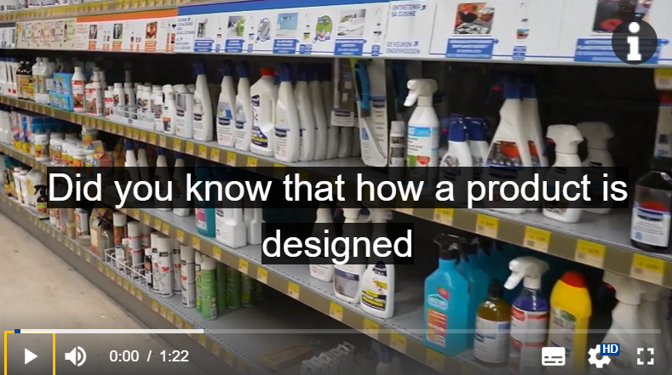
CE & Environmental Standards: The Ecodesign for Sustainable Products Regulation (ESPR)

Slide 17
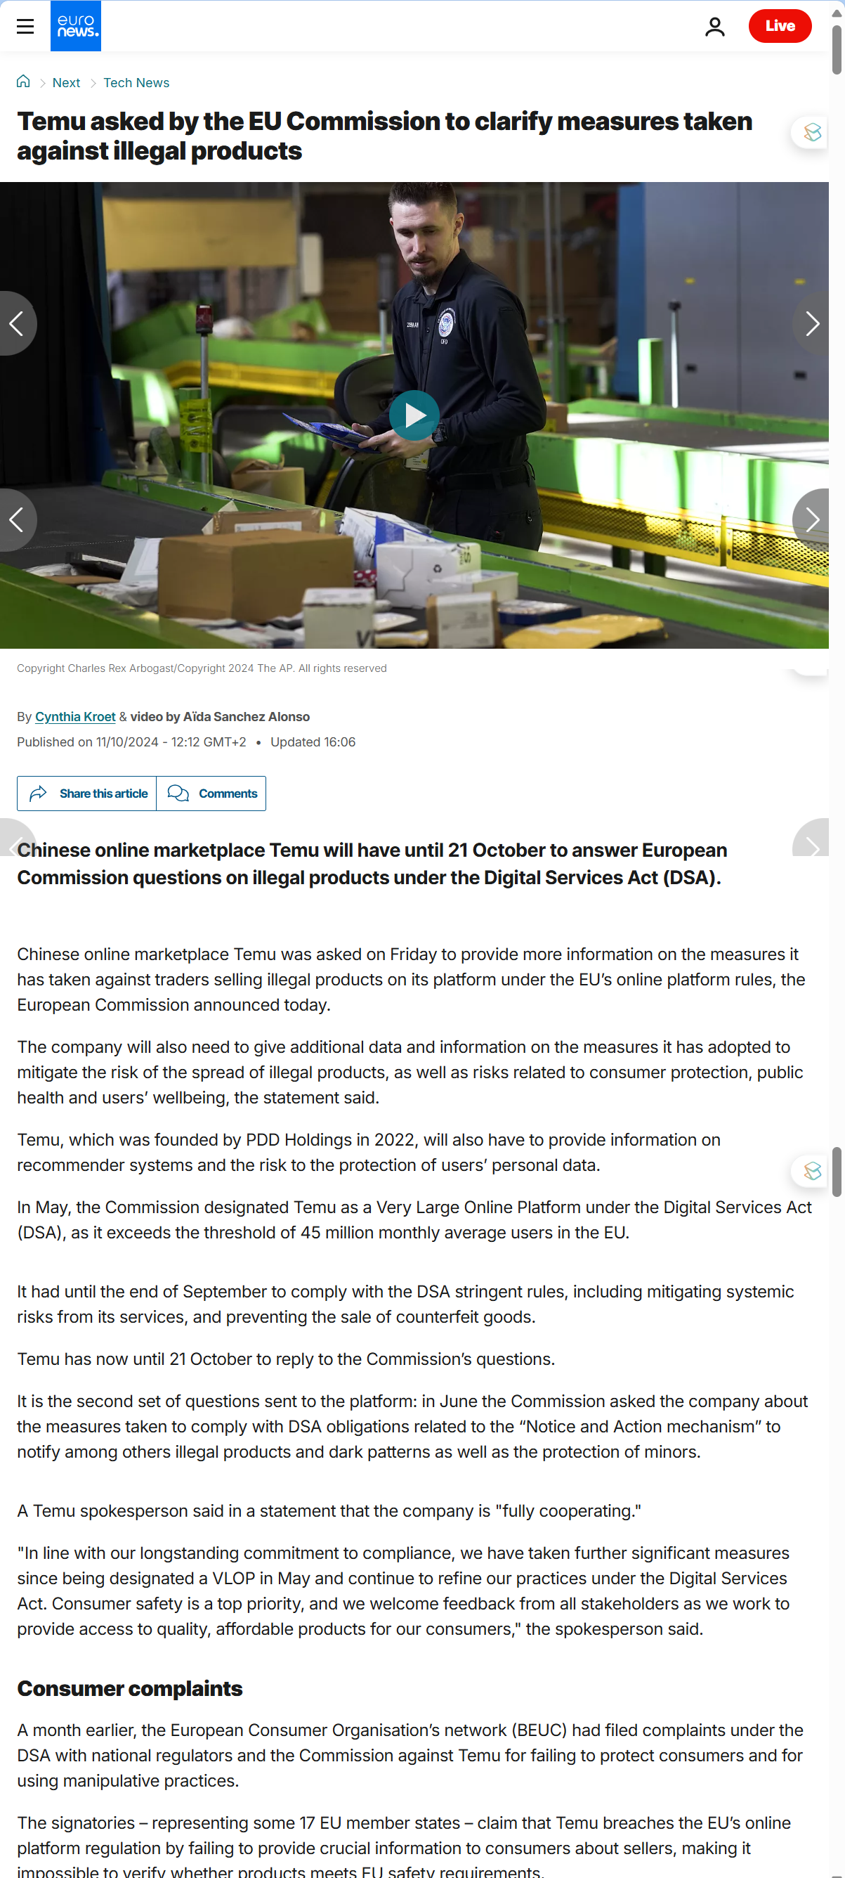
CE = Access to the European Economic Area*

Slide 18

How 2 CE your Stuff
Identify applicable CE directives / regulations and their essential requirements
Use harmonised EU standards and choose the conformity path
self‑assessment
Notified Body
Test the product, complete risk assessment, record results
Compile the technical file and sign the EU Declaration of Conformity
Affix the CE mark and keep all documents for 10 years

Slide 19
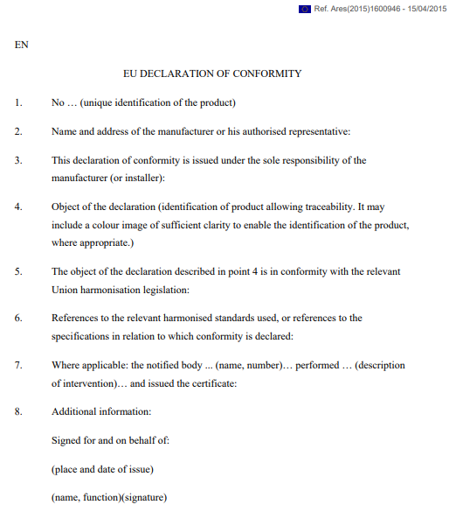
@ Declaration of Conformity

Slide 20
How 2 CE your Stuff
Identify applicable CE directives / regulations and their essential requirements
Use harmonised EU standards and choose the conformity path
self‑assessment
Notified Body
Test the product, complete risk assessment, record results
Compile the technical file and sign the EU Declaration of Conformity
Affix the CE mark and keep all documents for 10 years

Slide 21
So …
Health & safety standards
Environmental Standards
Company XY

Slide 22
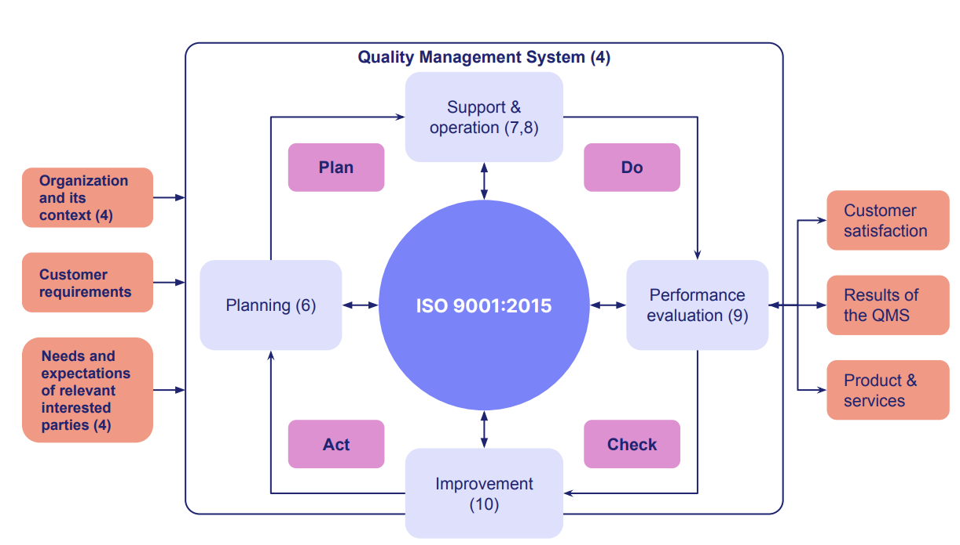
Demand for Quality Management Systems (QMS)
Notes:
Continuous Improvement: Plan-Do-Check-Act Model

Slide 23
Demand for Quality Management Systems (QMS) like ISO 9001
Main goal: Products/Services meet
Customer requirements
Regulatory requirements
Approach: Plan, do, check, act
Make your goals/performance measurable
Review them regularly
If below expectations: Continually improvement
Notes:
Continuous Improvement: Plan-Do-Check-Act Model

Slide 24
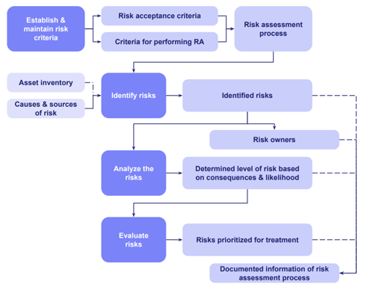
Demand for Quality Management Systems (QMS) like ISO 9001
Management principles:
Process approach
Risk-based thinking
Leadership commitment
PDCA cycle
Documented information
Internal audit
Corrective action
Continual improvement
Notes:
Continuous Improvement: Plan-Do-Check-Act Model

Slide 25
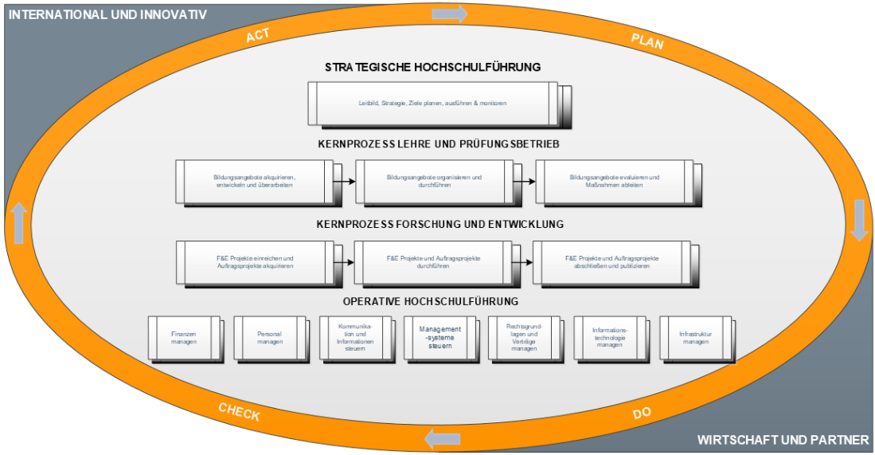
QMS @ IMC Krems

Slide 26
From QMS to EMS: Why not?
Main argument:
If you can manage business performance with QMS
you can manage environmental performance with an MS
👉 Environmental Management System (EMS)
Most prominent EMS approaches:
ISO 140001 & EMAS
Notes:
Business performance: KPI driven image of business results

Slide 27
Environmental Management Systems

Slide 28
What is an EMS?
🤔

Slide 29


What is an EMS?
The set of interrelated elements (processes, resources, documented information) used to implement environmental policy and manage aspects (cf. ISO 14001)
"A set of processes and practices that enable an organization to reduce its environmental impacts and increase its operating efficiency.“ (EPA, n.d.)
A tool for managing an organization's impacts on the environment and improving environmental performance through a system of continuous improvement.

Slide 30
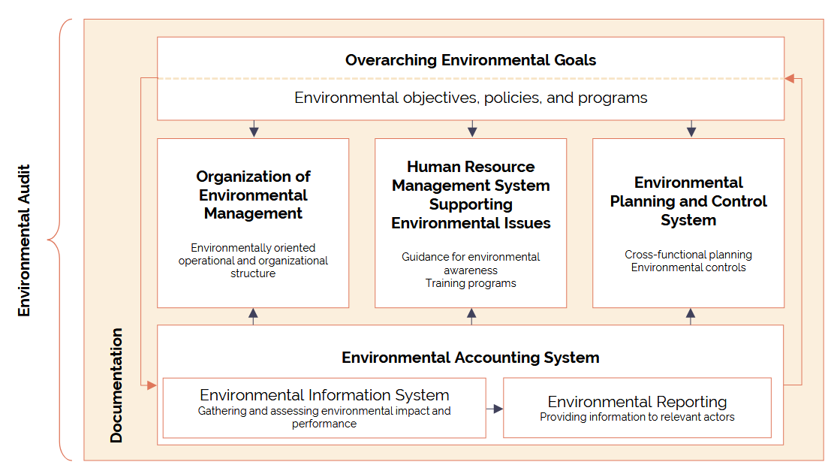
Typical Elements of an EMS

Slide 31
How Common are EMS (in AUT)?
 | Number of Companies | Number of Locations
AUT overall | 580,000
EMAS EMS | 287 | 1,515
ISO 14001 EMS | 2,200 | -
Examples ISO 14001:
OMV
Voestalpine
Verbund
AVL List
Andritz
Examples EMAS:
Austrian Airlines
Essity Austria
Egger
Magna Steyr Fahrzeugtechnik
Ebswien Hauptkläranlage

Slide 32
Benefits of EMS
Ideally: Improved environmental performance over time
Identify opportunities for waste reduction 👉 cost reduction
Inclusion of stakeholders
Competitive edge 👉 sometimes: entry barrier
Improve employee morale & binding
Demonstrate environmental activities to investors
Public relations

Slide 33
EMS a la ISO 14001

Slide 34
What EMS like ISO 14001 are and what they’re not:
What they deliver:
Management of environmental aspects you can control
Applicable for any organisation
Standard = optional
What they are not:
Substantial regulation/law
Commitment to become climate neutral
Mechanism forcing the disclosure of internal rules & data
Product standard
Public benchmarking system

Slide 35
ISO 14001 High-Level Structure
1. Scope
2. Normative References
3. Terms & Definitions
4. Context of the Organization
5. Leadership
6. Planning
7. Support
8. Operation
9. Performance Evaluation
10. Improvement

Slide 36
ISO 14001 Normative References
ISO 14004-2016 General guidelines on principles, systems and support techniques
ISO 14006-2020 Guidelines for incorporating eco-design
ISO 14031-2021 Performance evaluation guidelines
ISO 14044-2020 Life cycle assessment requirements and guidelines
ISO 14063-2020 Environmental communication guidelines and examples
ISO 19011-2018 Guidelines for auditing management systems

Slide 37
ISO 14001 Terms & Definitions
Term | Short definition
Environment | Surroundings in which an organization operates, including air, water, land, natural resources, flora, fauna, people and their inter-relationships.
Environmental Aspect | Element of an organization’s activities, products or services that can interact with the environment (e.g., energy use, waste generation).
Significant Environmental Aspect | An aspect that has—or can have—one or more significant environmental impacts, determined by the organization’s own criteria.
Environmental Impact | Any change to the environment—adverse or beneficial—resulting from an organization’s aspects.
Environmental Performance | Measurable results of how well an organization manages its environmental aspects and achieves its objectives.
Environmental Policy | Top-management statement of the organization’s overall intentions and direction related to environmental performance.
Environmental Objective | Specific overall environmental goal, consistent with the policy, that the organization sets to achieve.
Compliance Obligations | Legal and other requirements an organization must or chooses to meet.
Life Cycle Perspective | Consideration of environmental aspects and impacts from raw-material acquisition to end-of-life treatment.
EMS (Environmental Management System) | The set of interrelated elements (processes, resources, documented information) used to implement environmental policy and manage aspects.
Continual Improvement | Recurring process of enhancing the EMS to achieve better environmental performance.
Risk & Opportunity | Potential environmental-management events (negative or positive) that can affect objectives—addressed proactively in planning.
Interested Party | Person or organization that can affect, be affected by, or perceive itself to be affected by the EMS (e.g., regulators, neighbors).
Documented Information | Information the organization must control and maintain, in any medium (formerly “documents and records”).
Outsourced Process | A process needed for the EMS and controlled externally but within the scope of the system.
Nonconformity | Non-fulfilment of a requirement (e.g., missed monitoring, legal breach).
Corrective Action | Action to eliminate the cause of a nonconformity and prevent recurrence.
Internal Audit | Systematic, independent and documented process to obtain audit evidence and evaluate it objectively.
Top Management | Person(s) who direct and control the organization at the highest level, accountable for the EMS.

Slide 38
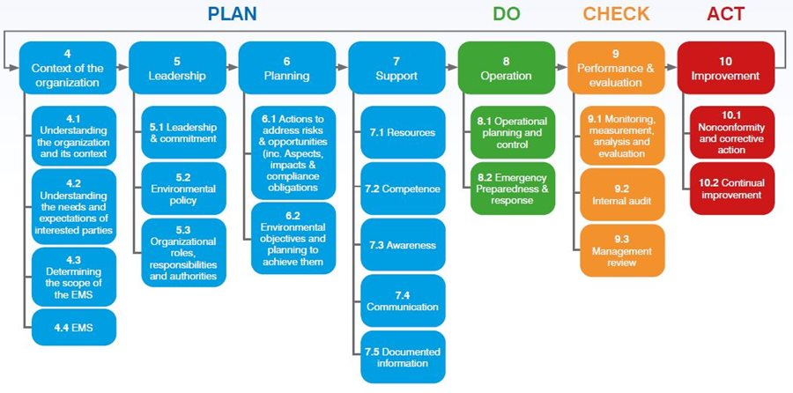
The ISO 14001 PDCA-Approach

Slide 39
The ISO 14001 PDCA-Approach: Context & Planning
@ Understanding the organisation and its context:
Identify & evaluate environmental aspects of its own (current & planned) activities, products, and services that it can
control or
influence
Emissions to air
Discharges to water
Waste management
Use of raw materials and natural resources
Energy use and efficiency
Land contamination and use
Noise, vibration, odour, and radiation
Transport and logistics
Product lifecycle impacts
Biodiversity and ecosystems

Slide 40
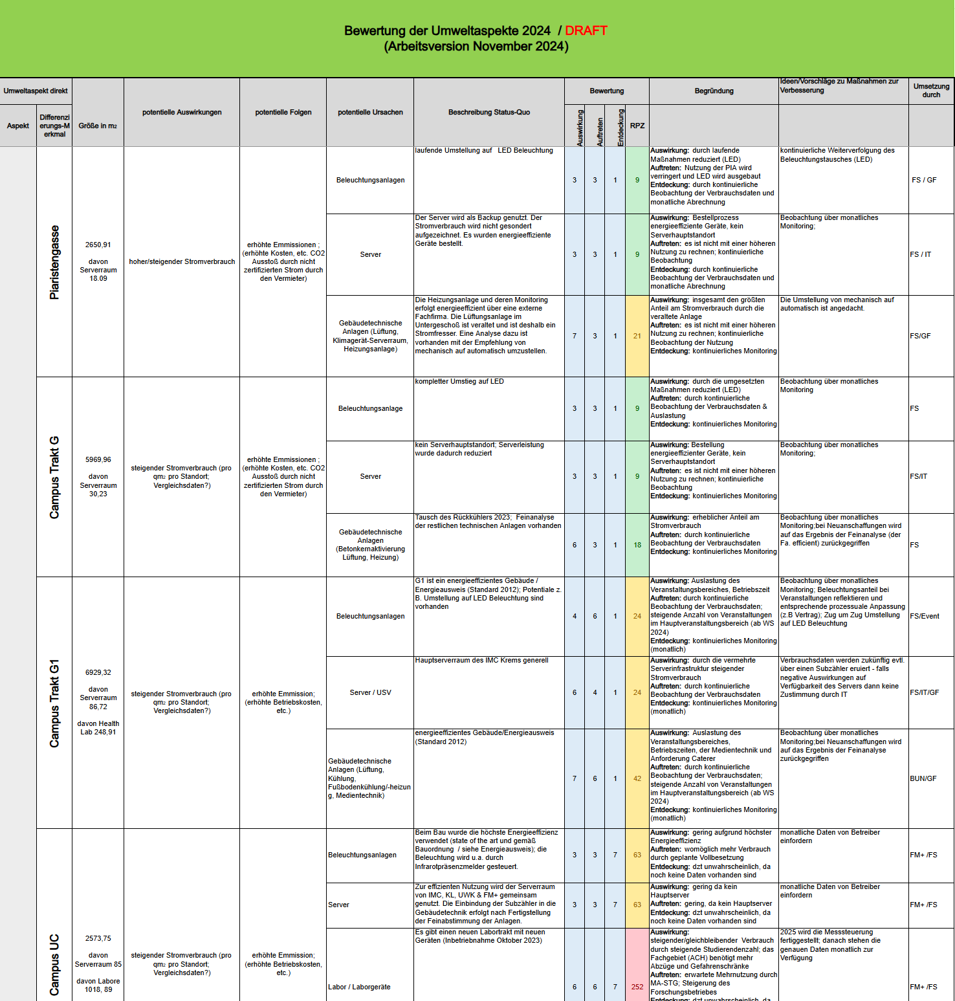
@ From Context to Planning: Risks & Opportunities as Linking Elements

Slide 41
The ISO 14001 PDCA-Approach

Slide 42
The ISO 14001 PDCA-Approach: Leadership & Planning
Top management = committed & involved in design & implementation of EMS
Tom management 👉 Environmental Policy
Input & participation
Communicate & implement

Slide 43
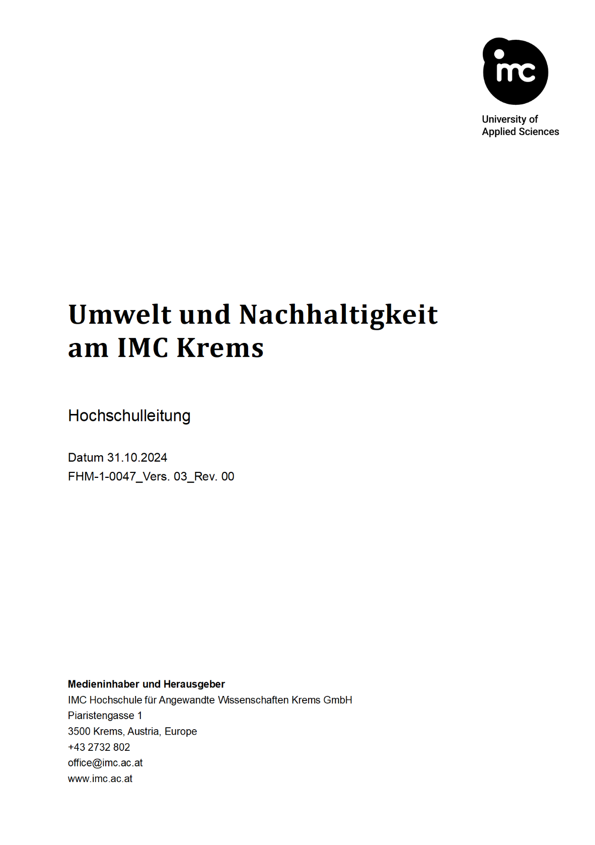
@ Leadership: Environmental Policy

Slide 44
The ISO 14001 PDCA-Approach

Slide 45
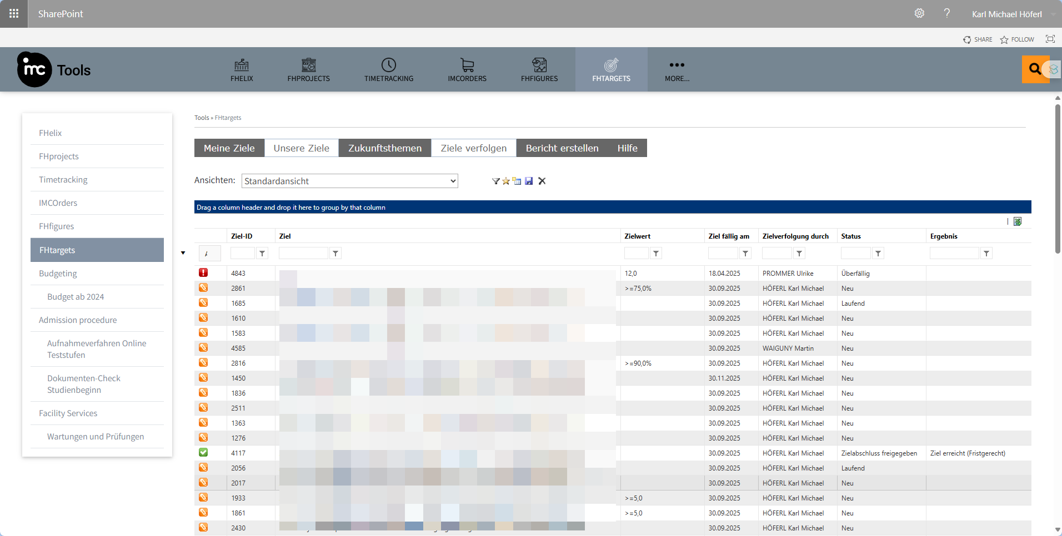
@ Operational Planning & Control: Operational Goals/Targets

Slide 46
The ISO 14001 PDCA-Approach

Slide 47
The ISO 14001 PDCA-Approach: Leadership, Evaluation & Improvement
Top management:
Conduct management review of policies & environmental performance
Draw conclusions for continuous improvement
Processes
policies

Slide 48
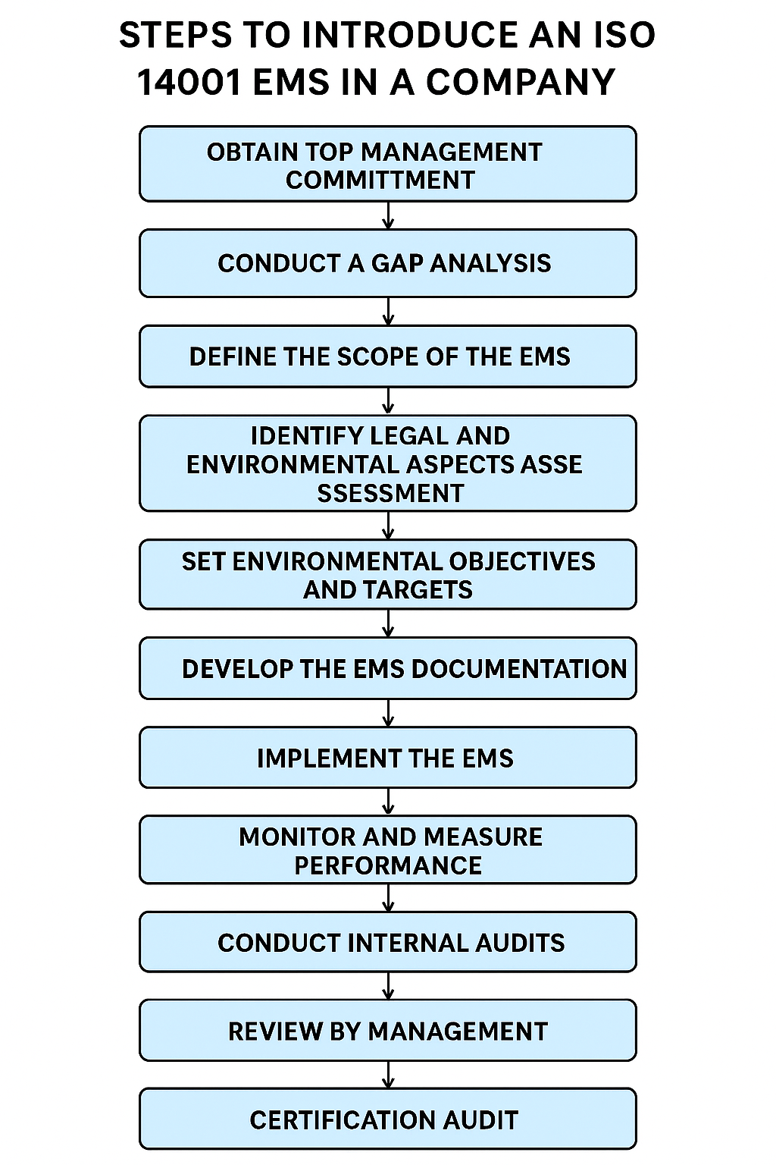
How to Certify a Company for ISO 14001
@ certification audit: accredited, independent certification body
Stage 1 - Documentation Review / Readiness Audit:
Review of EMS documentation and preparedness for stage 2 audit
Manuals, procedures & key records (internal audit reports, management review minutes etc.)
Stage 2 - On-Site Certification Audit:
evaluate the implementation and effectiveness of EMS in practice

Slide 49
How to Certify a Company for ISO 14001
@ audits in general:
Initial certification: valid 3 years
Annual surveilance audits by certified body
Recertification audit: every 3 years

Slide 50
ISO 14001: The Silver Bullet We have been Looking For?
Implementation challenges:
Documentation-heavy
Resource-intensive
Integration difficulties
Performance issues:
Focuses on systems 👉 not environmental outcomes
unambitious environmental objectives
Strategic shortcomings:
Can be a compliance "box-ticking exercise„
Limited (environmental) scope
May not drive real innovation
Certification process:
Inconsistent quality among certification bodies
Potential auditor conflicts of interest
Limited transparency in audit findings

Slide 51
EMS a la EMAS

Slide 52
What is EMAS?
🤔

Slide 53
Well, a Beefed-Up Version of ISO 😉
EMAS = Eco-Management and Audit Scheme
EU voluntary environmental management instrument established in 1993
Main idea = more “complete & transparent” than ISO
public environmental reporting through validated statements 👉 transparency
additional requirements for environmental performance 👉 “completeness”
employee involvement as a core component
independent verification by government-accredited verifiers
public registry

Slide 54
ISO vs. EMAS
Aspect | ISO 14001 | EMAS (Eco‑Management & Audit Scheme)
Type | Voluntary international ISO standard | EU Regulation 1221/2009 requiring formal registration
Oversight | Certificate issued by accredited certification body | Verification by accredited environmental verifier plus registration by national Competent Body
Public reporting | No mandatory external reporting beyond usual communications | Annual validated environmental statement must be published
Performance indicators | Organization chooses its own KPIs | Core EMAS KPIs on energy, material, water, waste, biodiversity and emissions must be disclosed
Continual improvement proof | Show progress toward self‑set objectives | Demonstrate measurable year‑on‑year environmental performance improvement

Slide 55
ISO vs. EMAS
Aspect | ISO 14001 | EMAS (Eco‑Management & Audit Scheme)
Type | Voluntary international ISO standard | EU Regulation 1221/2009 requiring formal registration
Employee involvement | Encouraged but not prescriptive | Explicit requirement for employee participation in EMS and audits
Legal compliance focus | Identify and evaluate compliance obligations | Compliance with relevant legislation must be proven before registration
Logo use | No specific logo, only the certificate mark of the certifier | Registered organizations may display the EMAS logo on documents, websites and products
Geographic reach | Recognized worldwide in both private and public sectors | Primarily recognized within EU / EEA and accession countries but accepted as best practice elsewhere

Slide 56
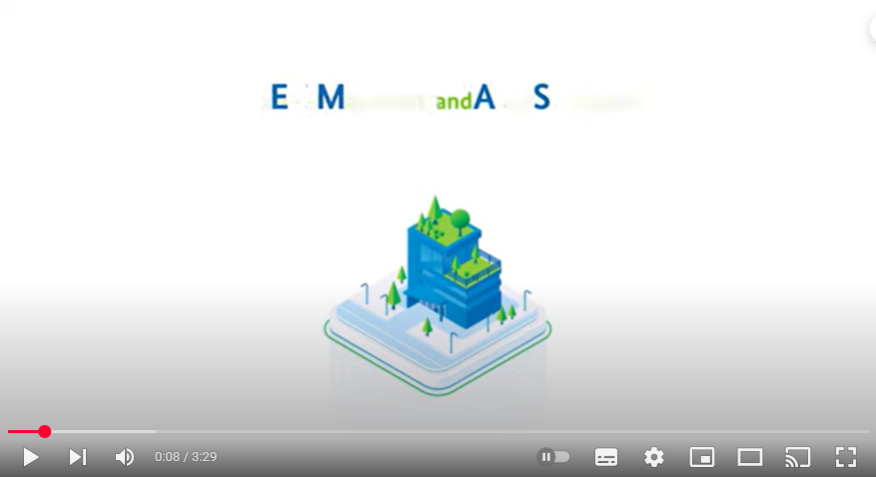
EMAS = Public Policy Instrument

Slide 57
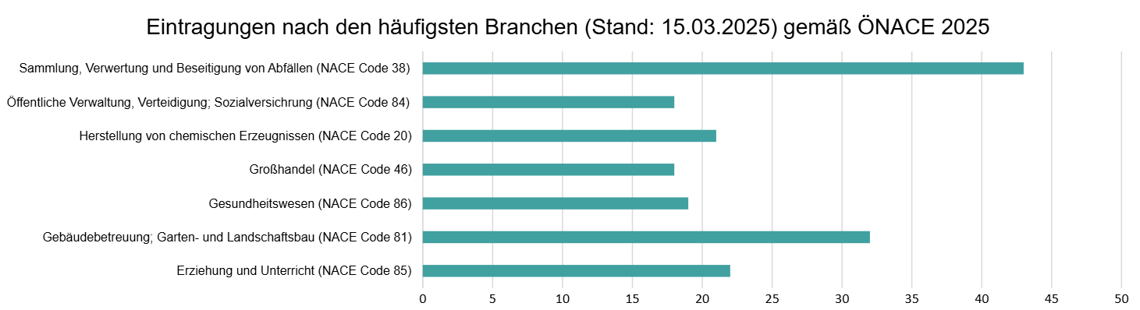
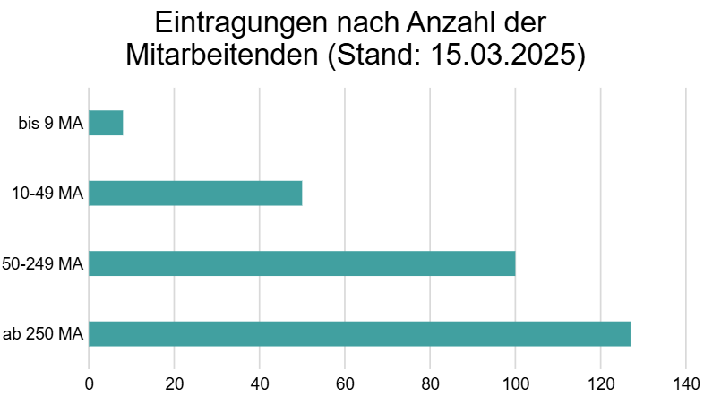
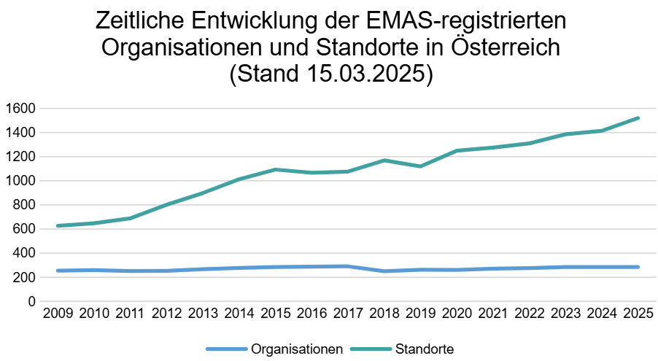
Who likes EMAS?

Slide 58
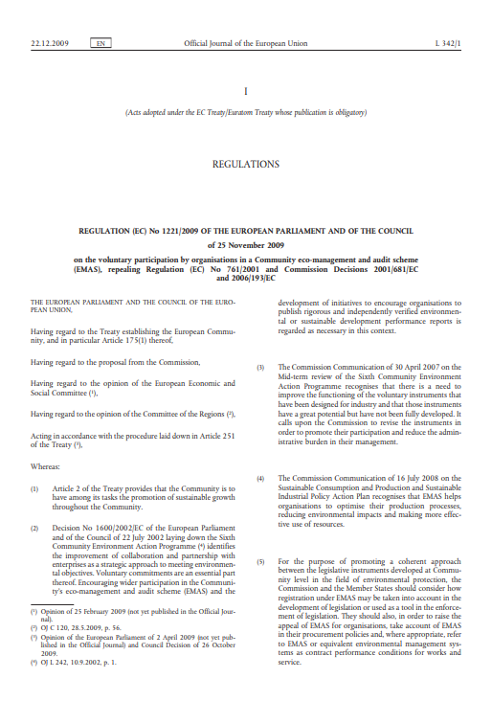
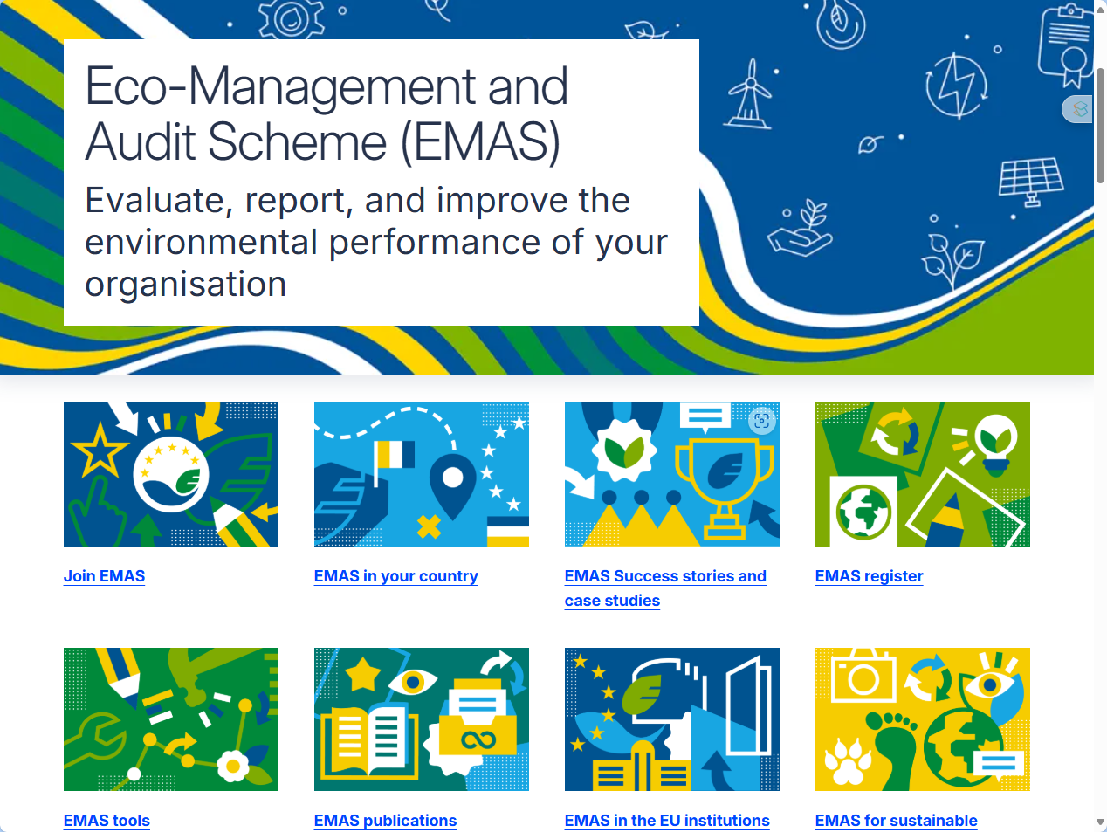
EMAS = Public Policy Instrument

Slide 59
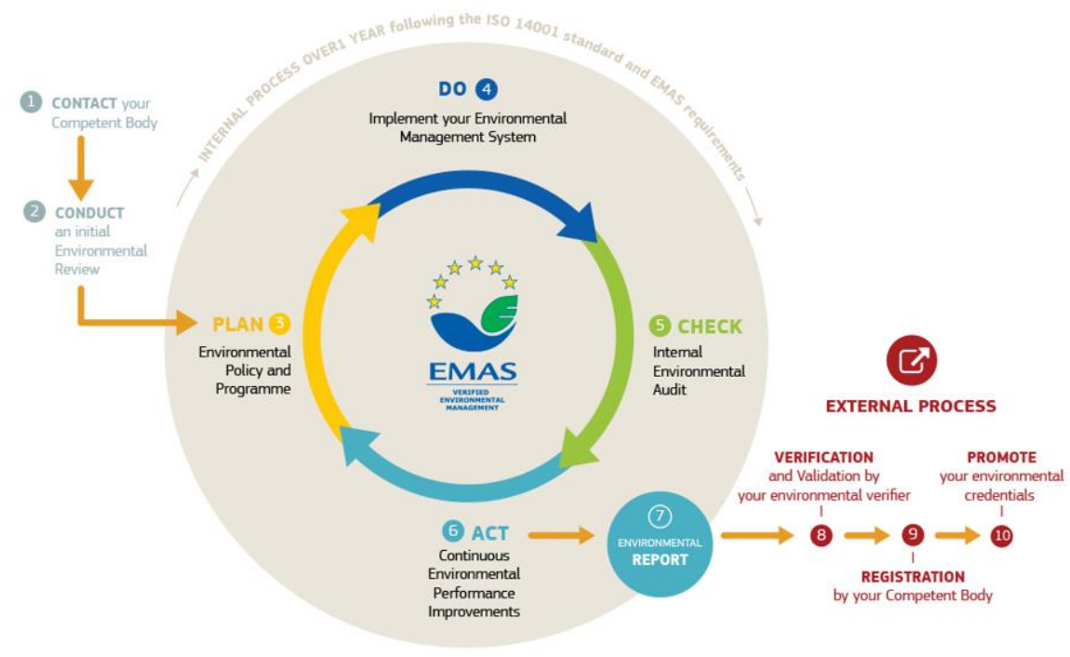
How 2 Become EMAS Certified

Slide 60
How 2 Become EMAS Certified
@ Initial environmental review:
Direct & indirect environmental impacts
Current environmental performance
Legal requirements
👉 Plan: basis for management to develop environmental policy & programme

Slide 61
How 2 Become EMAS Certified
@ Competent body:
Legally: Bundesministerium Land- und Forstwitschaft, Klima- und Umweltschutz, Regionen und Wasserwirtschaft
Operational:
Umweltbundesamt: handling applications
Umweltgutachter*innen: supporting companies
~ 8: Not that many: https://www.bmimi.gv.at/dam/jcr:2e9f74a4-9476-4faa-afaf-05099cd88444/EMAS_Umweltgutachter.pdf

Slide 62
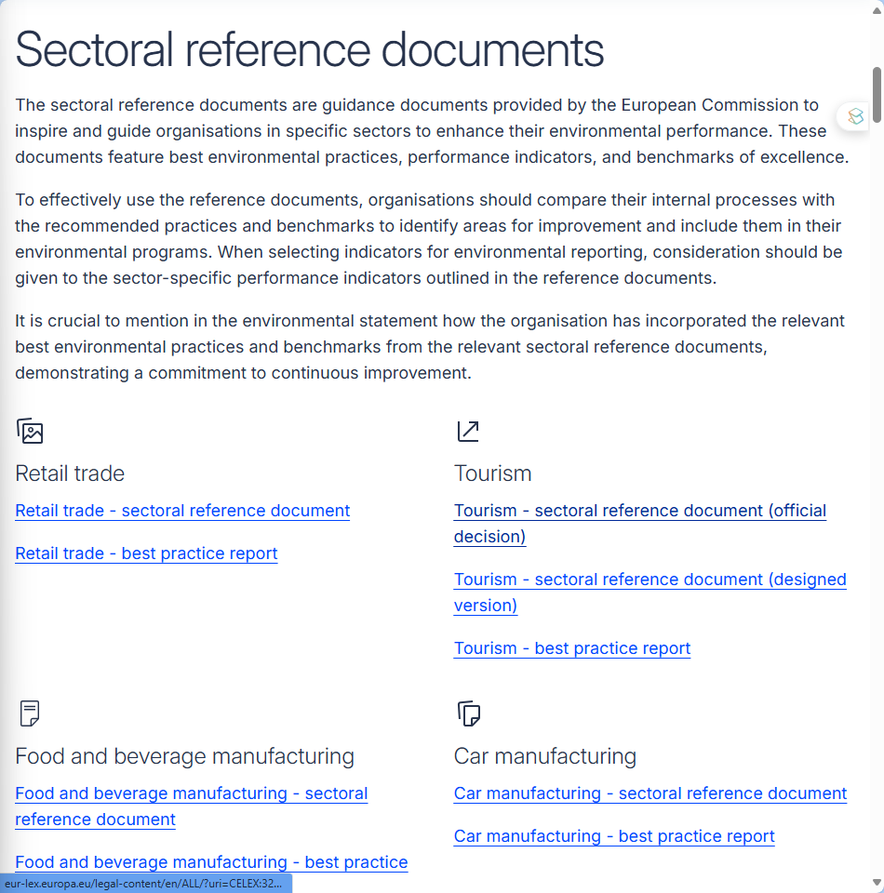
How is EMAS now More Complete than ISO?
In contrast to ISO: 👉 substantial environmental aspects which have to be covered
Due to sectoral differences:
Sectoral Reference Documents

Slide 63
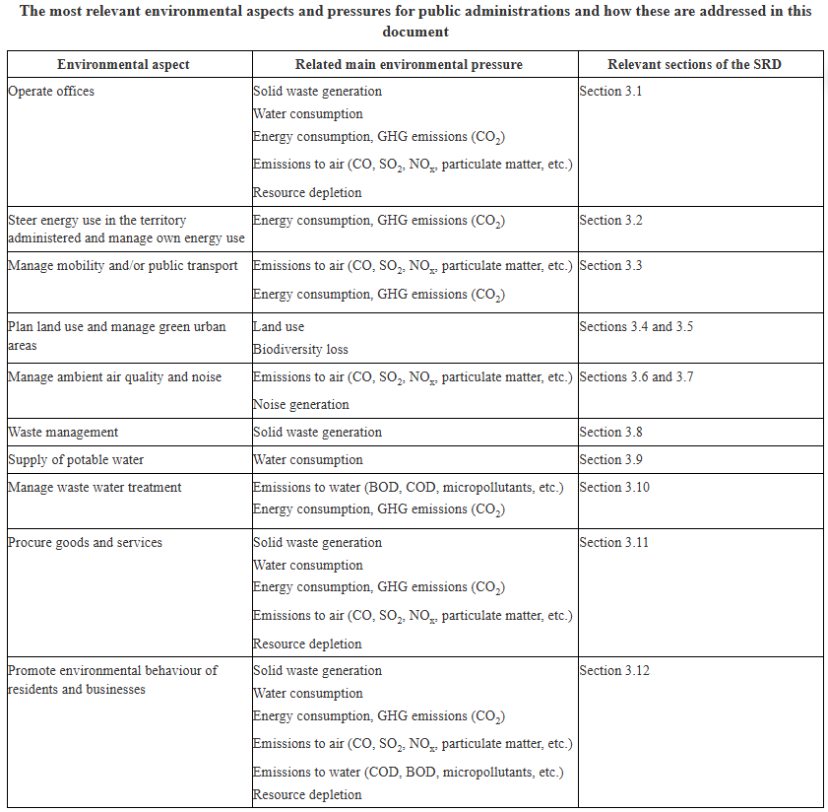


An Example: SRD Public Administration

Slide 64
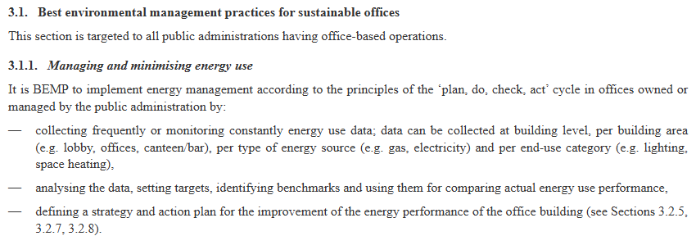
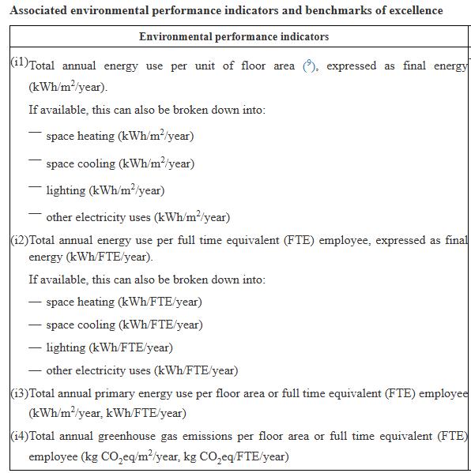
An Example: SRD Public Administration

Slide 65
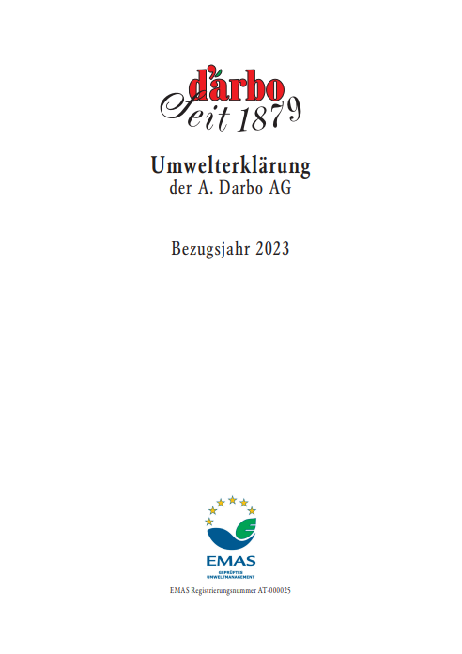
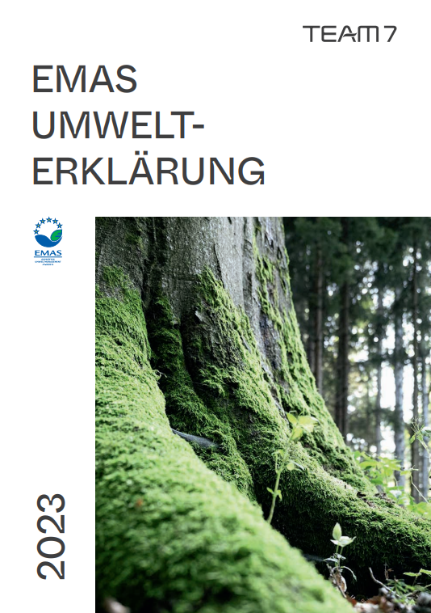
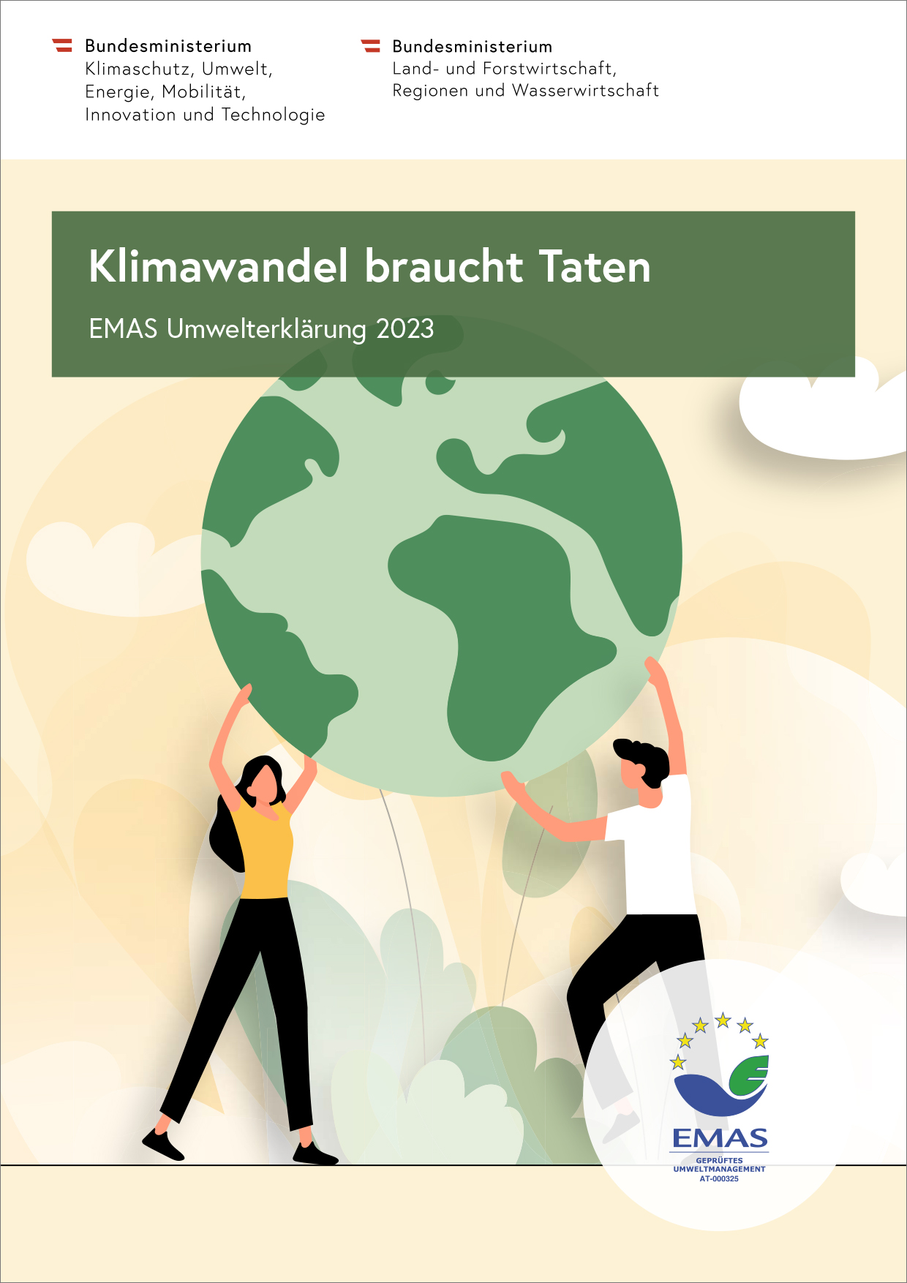
How is EMAS now More Transparent than ISO?
👉 Public Environmental Reports:

Slide 66
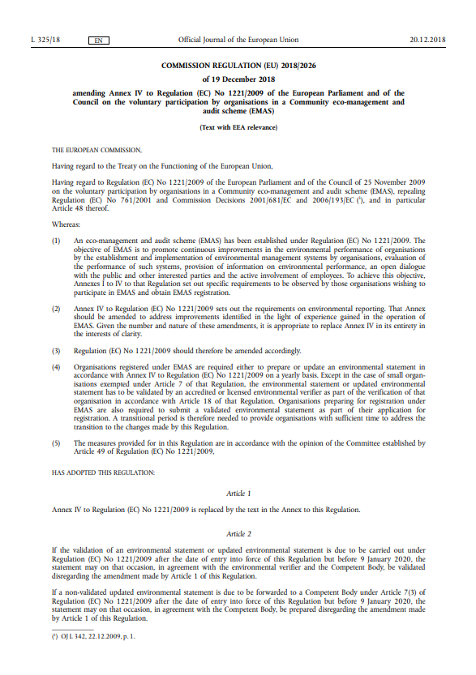
How is EMAS now More Transparent than ISO?
Structure & contents of public environmental reports: 👉Appendix IV of the EMAS regulation
(a) Organisation Overview (b) Environmental Policy (c) Description of the Environmental Management System (d) Environmental Objectives and Targets (e) Significant Environmental Aspects and Impacts (f) Environmental Performance Indicators (g) Legal Compliance (h) Validation by Environmental Verifier

Slide 67
EMAS: The Silver Bullet We have been Looking For?
Resource & implementation challenges:
Higher implementation costs than ISO
Challenging validation process
Significant management commitment
Accessibility issues:
Limited uptake among SME
Strategic & market concerns:
Limited global recognition outside EU
Potential competitive disadvantage because of transparency
Transparency & disclosure challenges:
Can expose organisations

Slide 68
Outlook

Slide 69
Wrap it up
Environmental Impact Assessment (EIA)
large-scale projects with significant environmental impacts 👉 precautionary principle
public participation, scoping, and multi-level licensing procedure
(Re-)Licensing Operational Facilities
Austrian Trade Regulation Act 👉 public interest: health, safety, environment, zoning
application, hearings, formal decision (“Bescheid”)
Waste Management & Waste Management Concept (WMC)
process descriptions, waste streams, logistics, and planning

Slide 70
Till next Session:

Slide 71
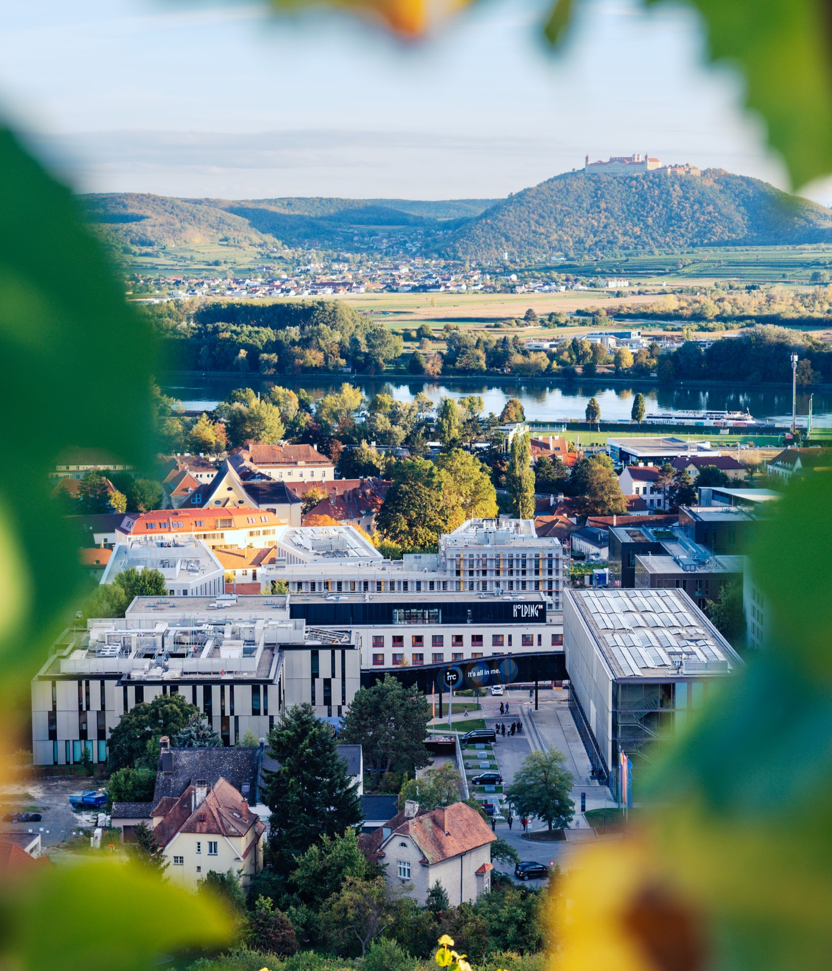

So long & cheerio!

